Slide 1
Insertion sort and Searching
Course Code: CSC 2106
Course Title: Data Structure (Theory)
Dept. of Computer Science
Faculty of Science and Technology
Lecturer No: | 5.2 | Week No: | 5 | Semester:
Lecturer: | Name & email

Slide 2
Lecture Outline
Searching
Linear Search (See Lecture 1.2)
Binary Search

Slide 3
Searching
Introduction
Search: locate an item in a list of data/information.
Two approaches will be discussed…
Linear or Sequential Search:
Searches sequentially for an element.
Starts from the first element.
Binary Search:
Searches an element by dividing the sorted elements in a list into two sub-list
Starts with the middle element.

Slide 4
Linear Search
Algorithm and Simulation
Algorithm:
Input: Array, #elements, item (to search)
Start with the element at index = 0
Step 1: Compare the element at index with item. If its equal to item then return index with status “Found” otherwise go to step 2.
Step 2: Increase index by 1. If index is less than #elements go to step 1 otherwise return -1 with status “Not found”.
index
index
index
index
index
index
value
11
false
found
true
0 | 1 | 2 | 3 | 4 | 5 | 6 | 7 | 8 | 9
33 | 66 | 22 | 111 | 77 | 11 | 99 | 55 | 88 | 44
position
5
-1

Slide 5
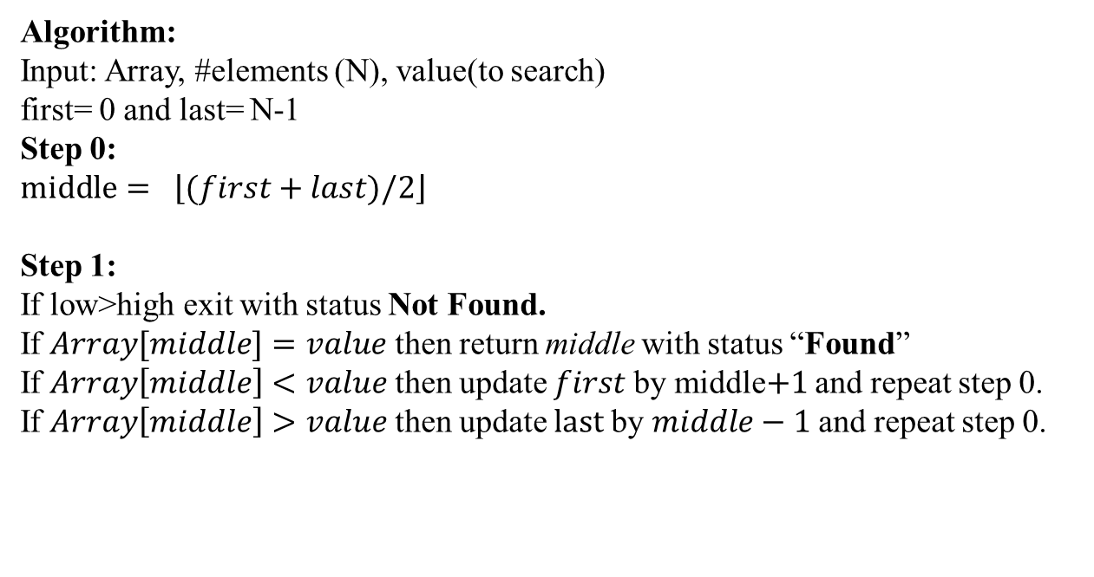
Binary Search
Algorithm
Algorithm:
Input: Array, #elements (N), value(to search)
first= 0 and last= N-1
Step 0:
$$middle= \left\lfloor (first+last)/2\right\rfloor$$
Step 1:
If low>high exit with status Not Found.
If $Array[middle]=value$ then return middle with status “Found”
If $Array\left[middle\right]<value$ then update $first$by middle$+1$ and repeat step 0.
If $Array\left[middle\right]>value$ then update $last$by $middle−1$ and repeat step 0.

Slide 6
Binary Search
Simulation
last
last
last
60
value
77
first
first
first
first
0
5
5
6
5
last
9
11
22
33
44
55
66
77
88
91
99
9
6
6
4
7
5
middle
6
4
0
1
2
3
4
5
6
7
8
9
middle
middle
middle
middle
found
not found

Slide 7
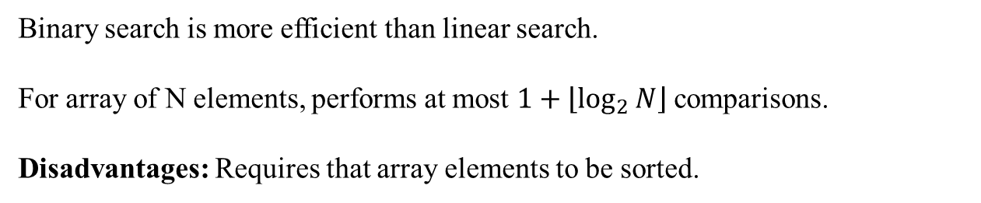
Search
Analysis
Binary search is more efficient than linear search.
For array of N elements, performs at most $1+\left\lfloor \log_{2}{N}\right\rfloor$comparisons.
Disadvantages: Requires that array elements to be sorted.

Slide 8
References
https://en.wikipedia.org/wiki/Insertion_sort
https://en.wikipedia.org/wiki/Sorting_algorithm
Nice animations are available here https://www.cs.usfca.edu/~galles/visualization/ComparisonSort.html
https://en.wikipedia.org/wiki/Linear_search
https://en.wikipedia.org/wiki/Binary_search_algorithm

Slide 9
Books
“Schaum's Outline of Data Structures with C++”. By John R. Hubbard
“Data Structures and Program Design”, Robert L. Kruse, 3rd Edition, 1996.
“Data structures, algorithms and performance”, D. Wood, Addison-Wesley, 1993
“Advanced Data Structures”, Peter Brass, Cambridge University Press, 2008
“Data Structures and Algorithm Analysis”, Edition 3.2 (C++ Version), Clifford A. Shaffer, Virginia Tech, Blacksburg, VA 24061 January 2, 2012
“C++ Data Structures”, Nell Dale and David Teague, Jones and Bartlett Publishers, 2001.
“Data Structures and Algorithms with Object-Oriented Design Patterns in C++”, Bruno R. Preiss,

